Slide 1
Linear Algebra
Lecture 8

Slide 2
Systems of
Linear Equations

Slide 3
Linear
Independence

Slide 4
Linear
(In)dependence
Definition

Slide 5
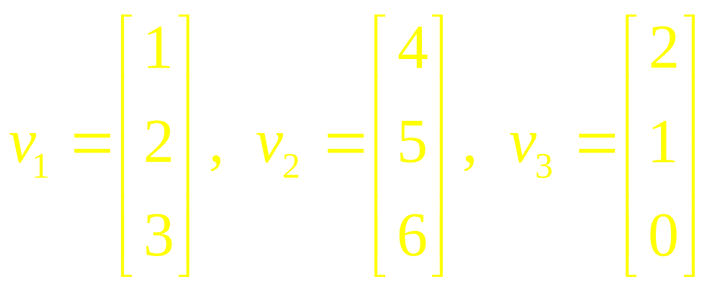
Example 1

Slide 6
Linear Independence
of Matrix Columns

Slide 7
Important Fact
The columns of a matrix A are linearly independent if and only if the equation Ax = 0 has only the trivial solution.

Slide 8
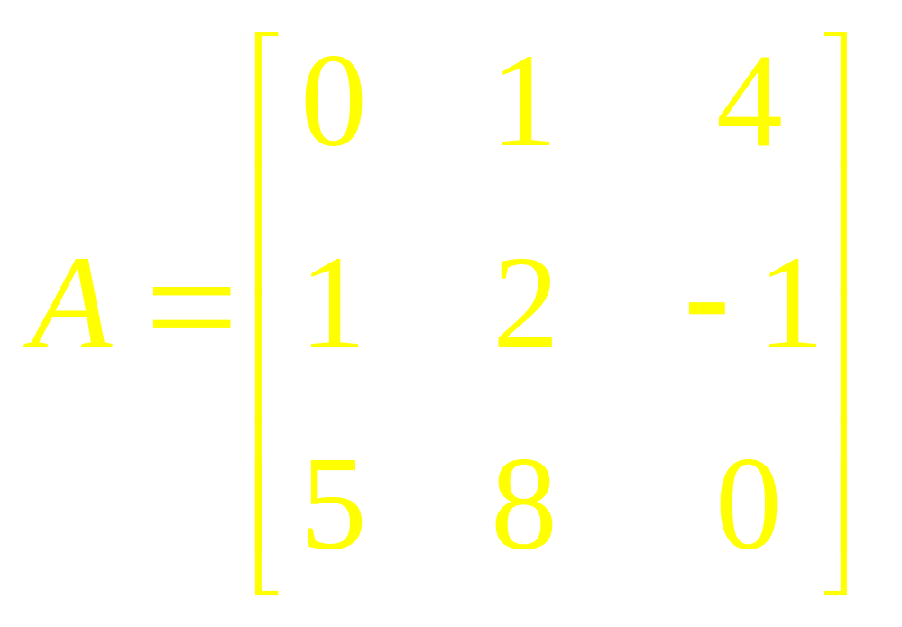
Example 2

Slide 9
Sets of one or
two Vectors

Slide 10
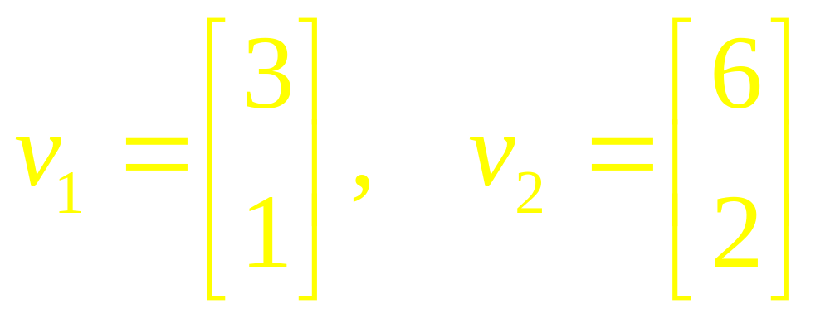
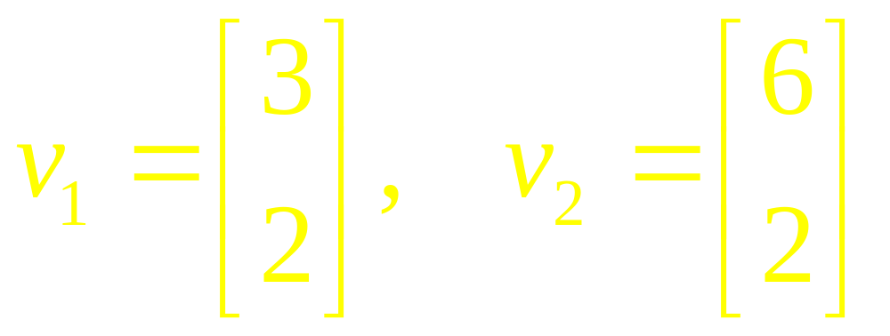
Example 3

Slide 11
Sets of two or
more Vectors

Slide 12
Important
Theorem

Slide 13
Example 4

Slide 14
Theorem

Slide 15
Example 5

Slide 16
Theorem

Slide 17
Example 6

Slide 18
Proof of
Theorem

Slide 19
Linear Algebra
Lecture 8

